Slide 1



SENTIMEN ANALISIS BERBASIS ASPEK PADA PERUMDA AIR MINUM SURYA SEMBADA SURABAYA MENGGUNAKAN KOMPUTASI KORELASI
Dicky Syarif Renaldi - 3322600009
ADVISORS
Entin Martiana K, S.Kom., M.Kom.
NIP. 197505302003121001
Aliridho Barakbah S.Kom, Ph.D
NIP. 197308162001121001
DEPARTMENT OF INFORMATICS AND COMPUTER
ELECTIONIC ENGINEERING POLYTECHNIC INSTITUTE OF SURABAYA
2026

Slide 2


OBJECTIVES
1
2
3
By using cosine similarity and rule-based sentiment
analysis, the system is expected to perform better for
short, unstructured comment data.
It should be able to understand whether
comments express positive, negative, or
neutral feelings toward PDAM services.
The system is expected to classify comments
based on 10 topics without manual intervention.

Slide 3
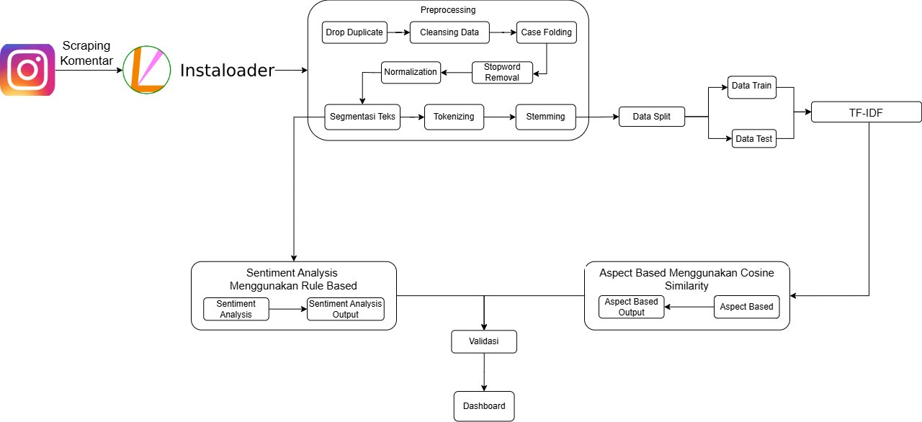
SYSTEM DESIGN

Slide 4
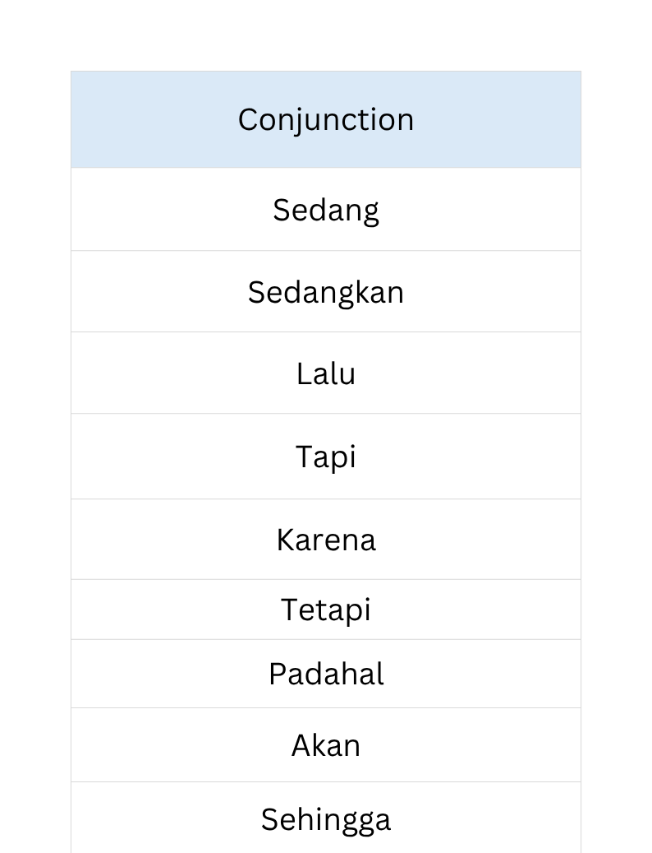
TEXT SEGMENTATION
Text segmentation is performed to divide multi-aspect comments into smaller segments, allowing each complaint context to be analyzed independently. The segmentation process uses conjunction-based rules to detect aspect boundaries, ensuring that each segment contains a single dominant aspect. This approach improves aspect classification accuracy by reducing context overlap within a comment

Slide 5
DATA SPLIT
Scenario 1
Training Data: Non Segmented Data (Single Aspect)
Test Data: Segmented Data (Multi Aspect Only
Test data containe only segmented comments
No test instance is compared with itself in the training set
Used to evaluate the model on unseen aspect segments
Scenario 2
Training Data: Non Segmented Data (Single Aspect)
Test Data: Full Dataset (100% data)
Test Data contains both segmented and non segmented comments
Some test instances may also exist in the training set
Designed to to examine the impact of self comparison on prediction result

Slide 6
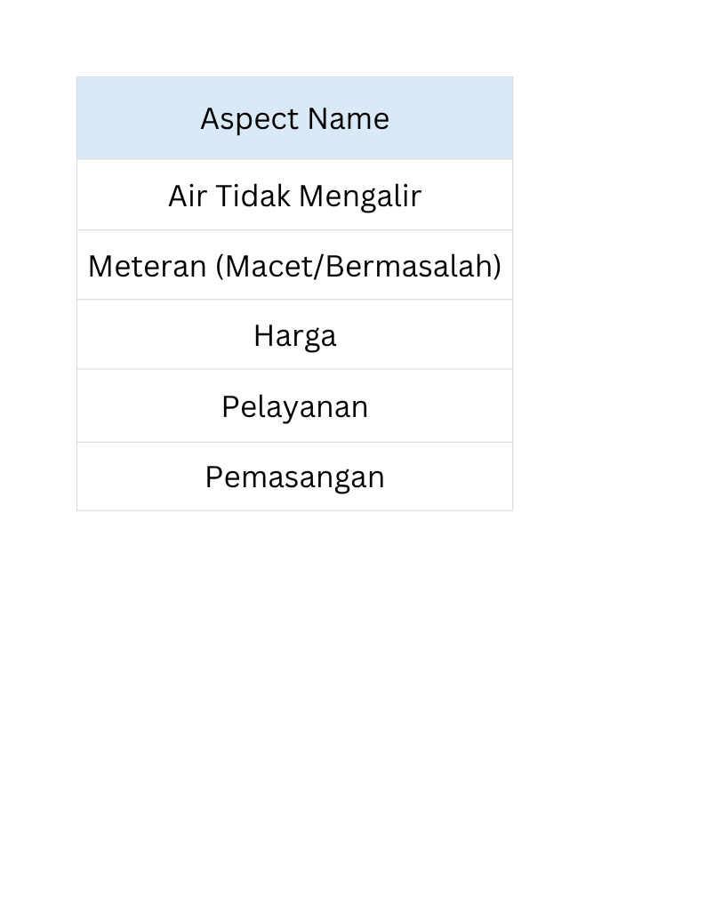
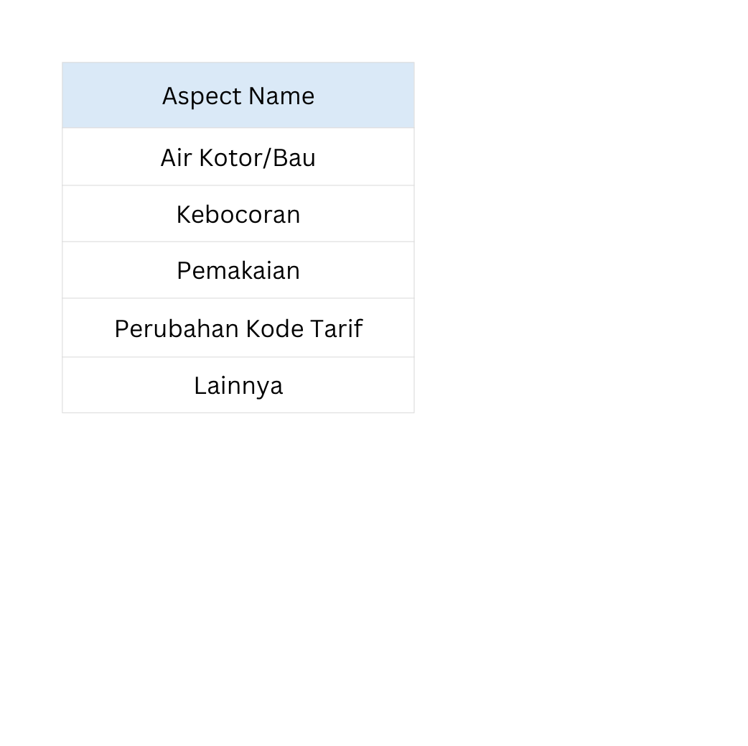
ASPECT USED
In the aspect-based stage, the author defined 10 aspects as shown in Table:
These aspects were determined based on two main sources: the aspects already available in the PDAM CIS application (Air Kotor/Bau, Kebocoran, Meteran (Macet/Bermasalah), Air Tidak Mengalir, Pemakaian, Perubahan Kode Tarif)
The author’s own observations after reviewing the dataset (Pemasangan, Pelayanan, Harga, Lainnya).

Slide 7
ASPECT BASED MODEL EVALUATION
A. Scenario 1 (Training Data: Non-Segmented Data | Testing Data: Segmented Data)
1. First Experiment (N-Gram = (1,3), Primary Threshold = 0.60, Others Threshold = 0.18)
In the first experiment of Scenario 1, the system produced 3,784 correct predictions and 1,308 incorrect predictions, achieving an accuracy of 74.31% and an average F1-score of 0.7052. These results indicate that the model was able to classify aspects in segmented data reasonably well. However, distinguishing between aspects with similar or closely related contexts remained a challenge

Slide 8
ASPECT BASED MODEL EVALUATION
2. Second Experiment (N-Gram = (1,2), Primary Threshold = 0.60, Others Threshold = 0.18)
In the second experiment of Scenario 1, the system produced 3,606 correct predictions and 1,476 incorrect predictions, achieving an accuracy of 70.82% and an average F1-score of 0.6813. This performance is lower than that of the first experiment, indicating that the use of only unigrams and bigrams is less effective in capturing the context of segmented data compared to using n-grams up to trigrams.

Slide 9
ASPECT BASED MODEL EVALUATION
B. Scenario 2 (Training Data: Non-Segmented Data | Testing Data: 100% Data)
1. First Experiment (N-Gram = (1,3), Primary Threshold = 0.60, Others Threshold = 0.18)
In the first experiment of Scenario 2, the system produced 19,003 correct predictions and 1,362 incorrect predictions, achieving an accuracy of 93.31% and an average F1-score of 0.8841. These results indicate that the model performs very well in identifying aspects when the testing data consists of the entire dataset, including both non-segmented and segmented comments. Under this condition, many test instances share highly similar patterns with the training data, making it easier for the system to identify the appropriate aspect.

Slide 10
ASPECT BASED MODEL EVALUATION
2. Second Experiment (N-Gram = (1,2), Primary Threshold = 0.60, Others Threshold = 0.18)
In the second experiment of Scenario 2, the system produced 18,825 correct predictions and 1,540 incorrect predictions, achieving an accuracy of 92.44% and an average F1-score of 0.8749. These results indicate that the model still performs very well when the testing data consists of the full dataset. This suggests that the use of unigrams and bigrams alone is sufficient to capture aspect-related patterns in most customer comments.

Slide 11
RULE EXPLANATION
1.Single Adjective
The first rule is single adjectives. If a sentence contains an adjective with a sentiment value and it is not involved in any other rule combination, its sentiment value is directly used as the sentence score.
Example: the word lama is an adjective with a value of -1 →
score = sentiment(lama) = -1 → Negative
2.Single Verb
The second rule is single verbs. If a sentence contains a verb with a sentiment value and it is not paired with other rules, its value is directly applied.
Example: the word bayar is a verb with a value of -1 →
score = sentiment(bayar) = -1 → Negative

Slide 12
RULE EXPLANATION
3.Preposition + Adjective
This rule combines a preposition and an adjective using the AND operator.
Example: air dalam keruh → dalam = 1, keruh = -1 → AND(1, -1) = -1
The word air also has a value of -1 →
score = sentiment(air) + AND(dalam, keruh) = -1 + (-1) = -2 → Negative
4.Preposition + Verb
This rule combines a preposition and a verb, often appearing in negation forms.
Example: tidak ada kelanjutan → complaint penalty = -1, tidak = -1, ada = 0 →
score = complaint penalty + sentiment(tidak) + sentiment(ada) = -1 + (-1) + 0 = -2 → Negative

Slide 13
RULE EXPLANATION
5.Verb + Adjective
This rule combines a verb and an adjective using the NAND operator.
Example: bayar mahal → bayar = -1, mahal = -1 → NAND(-1, -1) = -1
The clause also includes air keruh = -1 and bau = -1 →
score = NAND(bayar, mahal) + sentiment(air keruh) + sentiment(bau) = -1 + (-1) + (-1) = -3 → Negative
6.Preposition + Verb + Adjective
This rule combines a preposition, verb, and adjective.
Example: air tidak keluar mati → tidak keluar = -1, mati = -1 →
score = sentiment(tidak keluar) + sentiment(mati) = -1 + (-1) = -2 → Negative

Slide 14
RULE EXPLANATION
7. Phrase Detection
The system identifies phrases stored in the phrase lexicon.
A phrase is treated as a single sentiment unit rather than separate words.
Phrase matching is performed before individual word scoring.
Example:
terima kasih → score = +1 → Positive
air mati → score = −1 → Negative
This rule helps capture sentiment that may not be accurately represented by individual words alone.
8.Strong Negative Phrase
The model recognizes specific phrases as strongly negative.
Example: tidak ada tanggapan →
score = sentiment(tidak ada tanggapan) = -1 → Negative

Slide 15
RULE EXPLANATION
9.Question Rule
The system assigns a neutral sentiment to questions without strong negative signals.
Example: pdam naik selalu? →
score = 0 → Neutral
10.Complaint Context Penalty
The system applies a penalty when detecting complaint-related context.
Example: aliran air tidak lancar → complaint penalty = -1, air = -1, tidak lancar = -1 →
score = -1 + (-1) + (-1) = -3 → Negative

Slide 16
SENTIMENT ANALYSIS EVALUATION
The Rule-Based Sentiment Analysis model was evaluated on 1,670 comment segments, consisting of 827 Negative, 568 Neutral, and 275 Positive instances. The model achieved an accuracy of 82.59%, with a precision of 84.11%, recall of 82.59%, and F1-score of 82.69%, indicating good performance in identifying sentiment polarity. Overall, the proposed rule-based approach demonstrates effective sentiment classification performance and provides transparent, interpretable decision-making through predefined linguistic rules and sentiment dictionaries.

Slide 17

CONCLUSION
This study successfully developed an Aspect-Based Sentiment Analysis system for PDAM Surya Sembada customer comments using Cosine Similarity for aspect classification and a Rule-Based approach for sentiment analysis. The best aspect classification performance was achieved using TF-IDF N-Gram (1,3), obtaining an accuracy of 74.31% on segmented test data and 93.31% on the full dataset. Meanwhile, the sentiment analysis model achieved an accuracy of 82.59% and an F1-score of 82.69%, demonstrating its effectiveness in identifying customer sentiment. The developed dashboard further enables automatic processing, monitoring, and visualization of customer feedback, helping PDAM better understand service issues and customer perceptions.

Slide 18
THANK YOU

